Slide 1
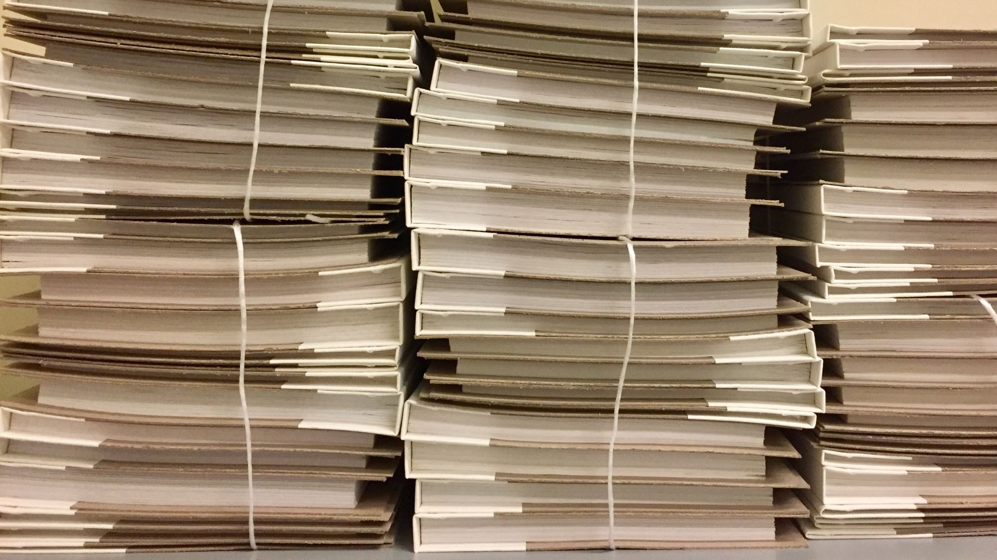
Full Stack Project Flow
Alfredo Uriarte
Susmi Rani
Asif Mujeeb
Karthik Janardhanan

Slide 2
ADMIN
EXAMINER
Driver

Slide 3

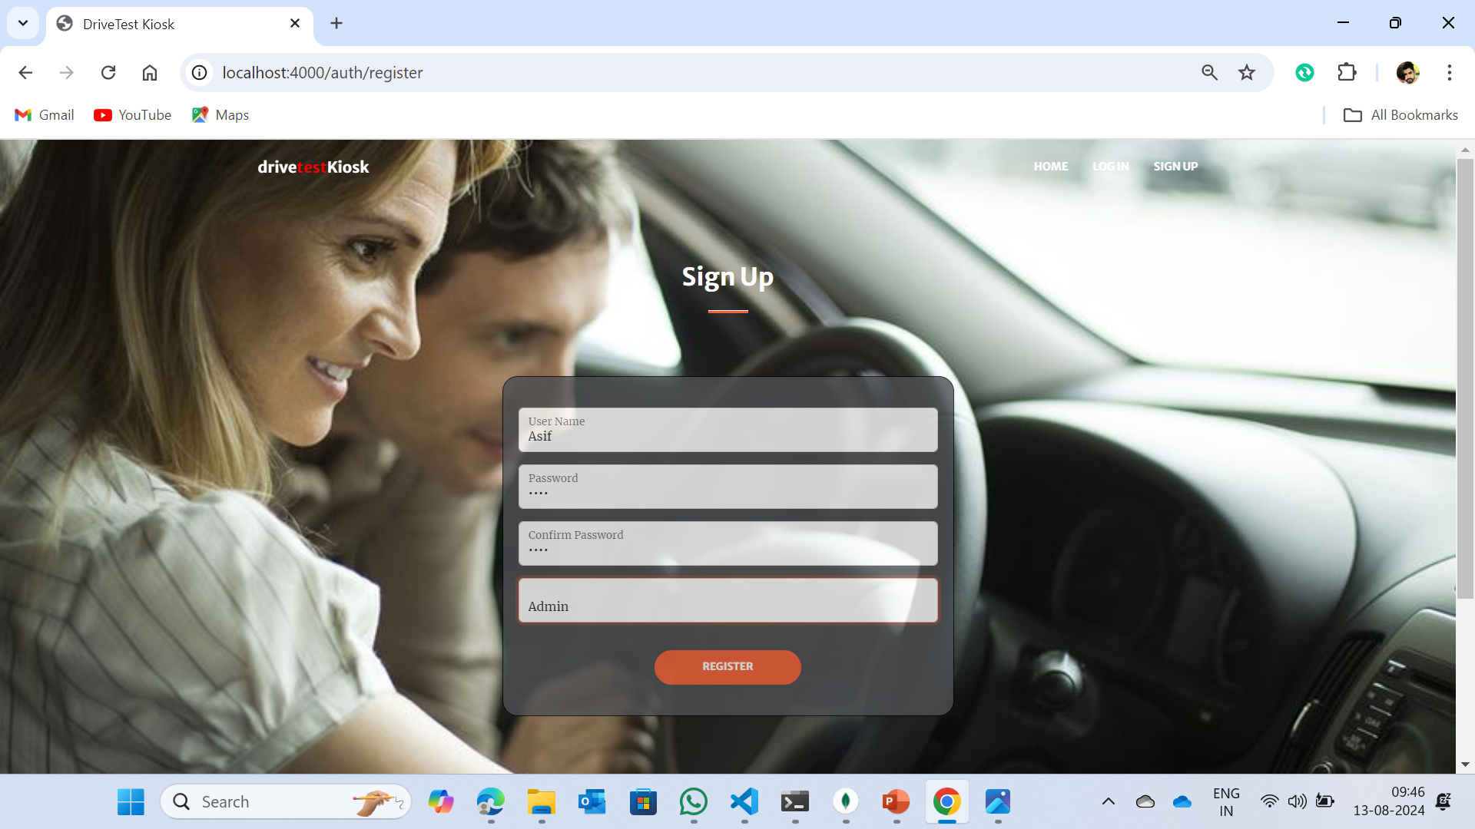
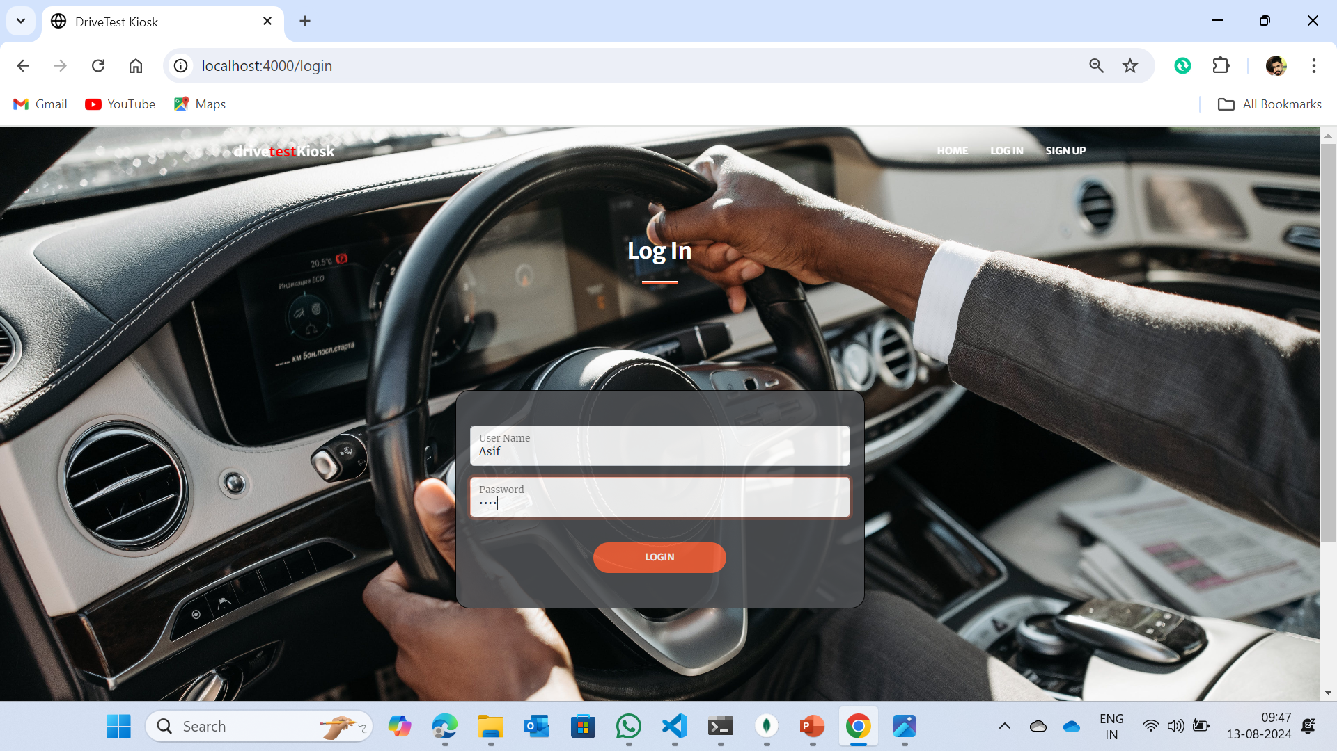
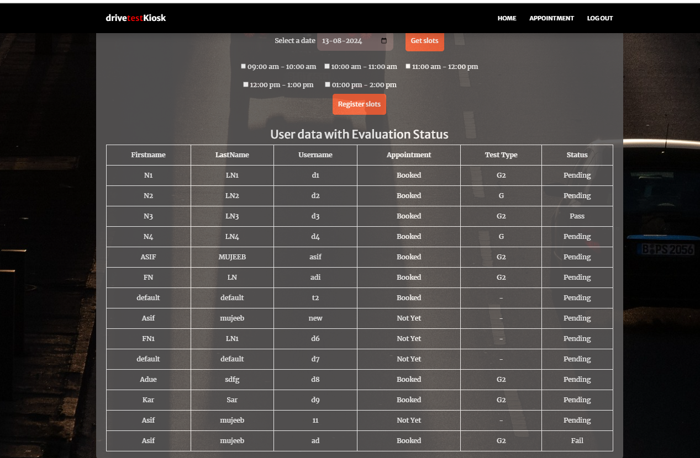
Admin Life Cycle

Slide 7
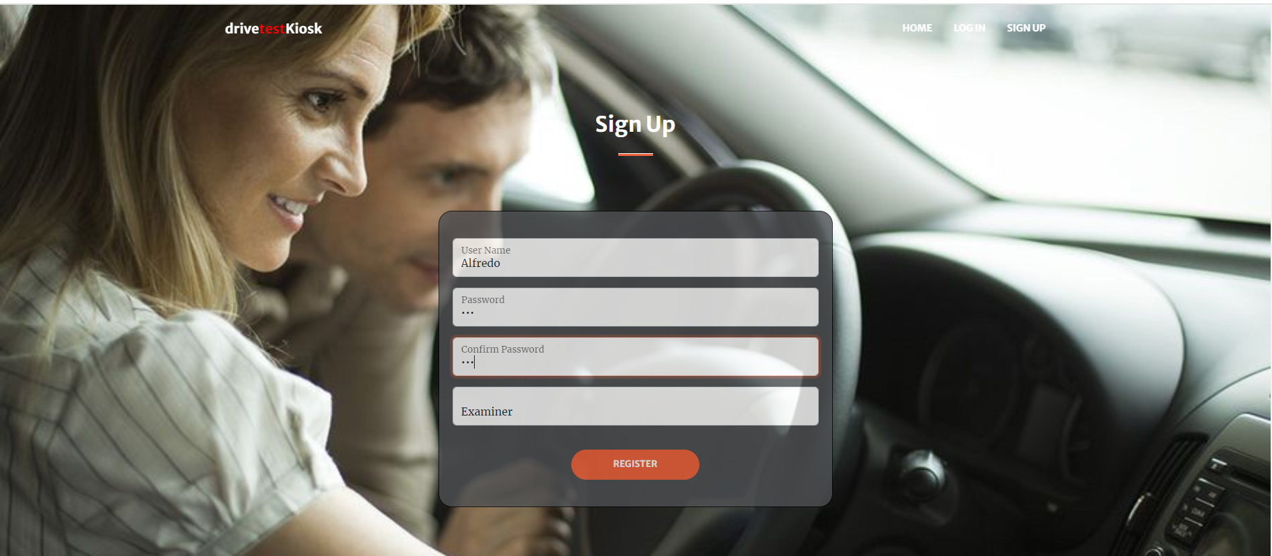
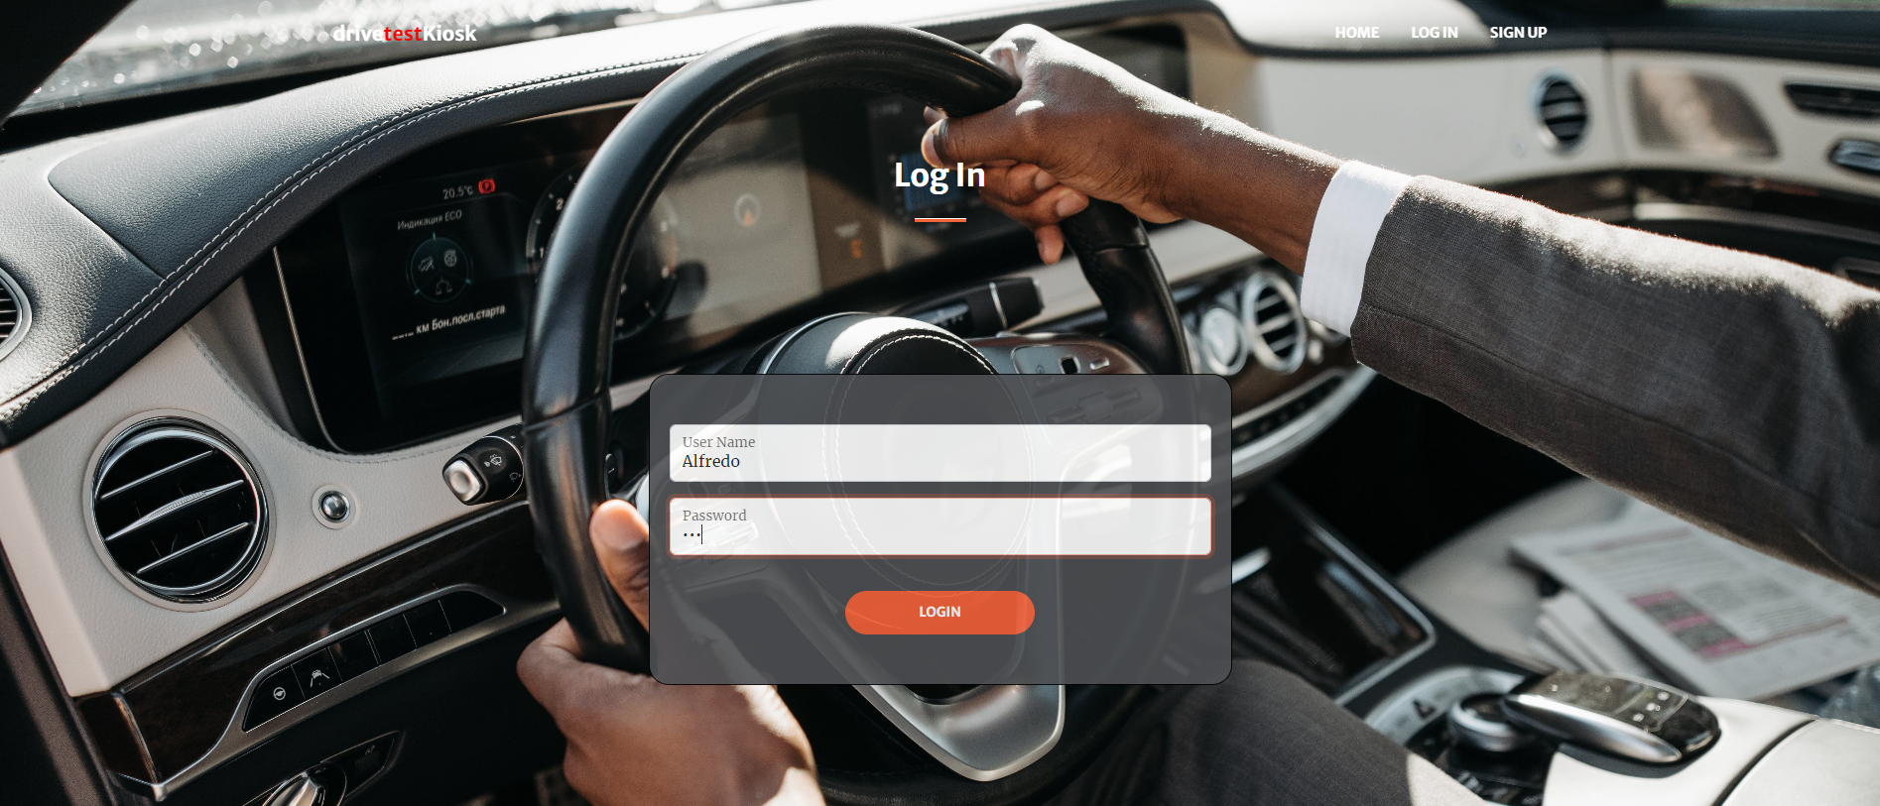
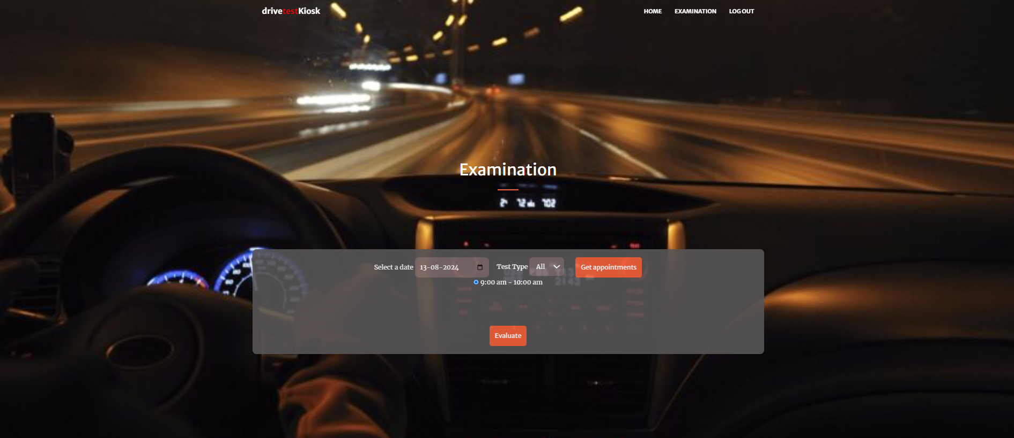
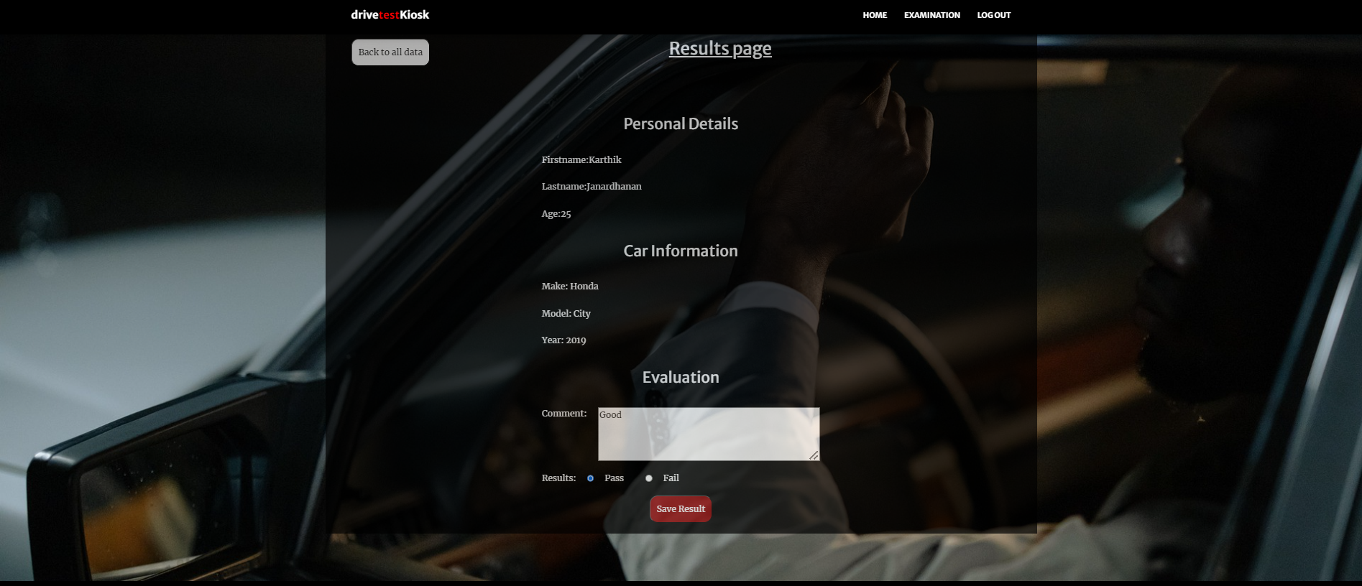
Examiner Life Cycle

Slide 12
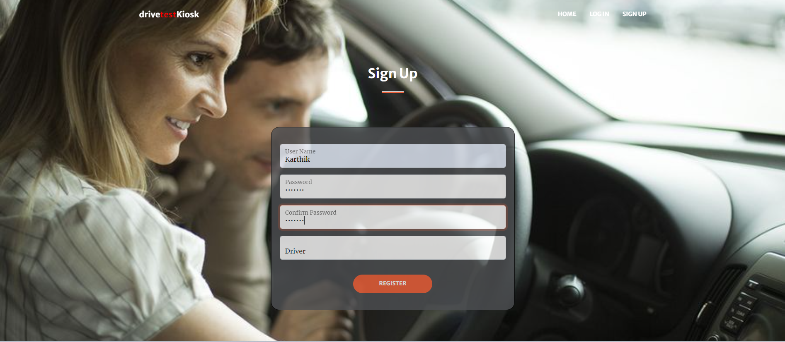

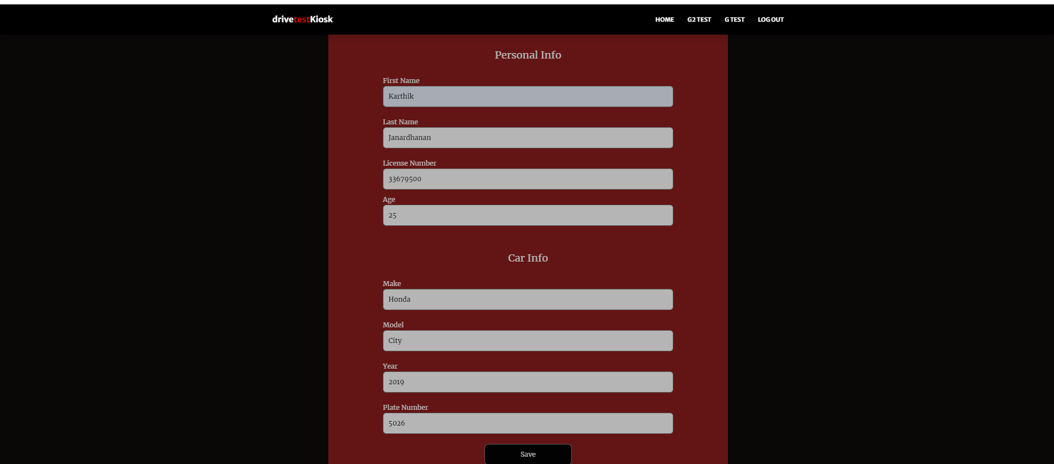
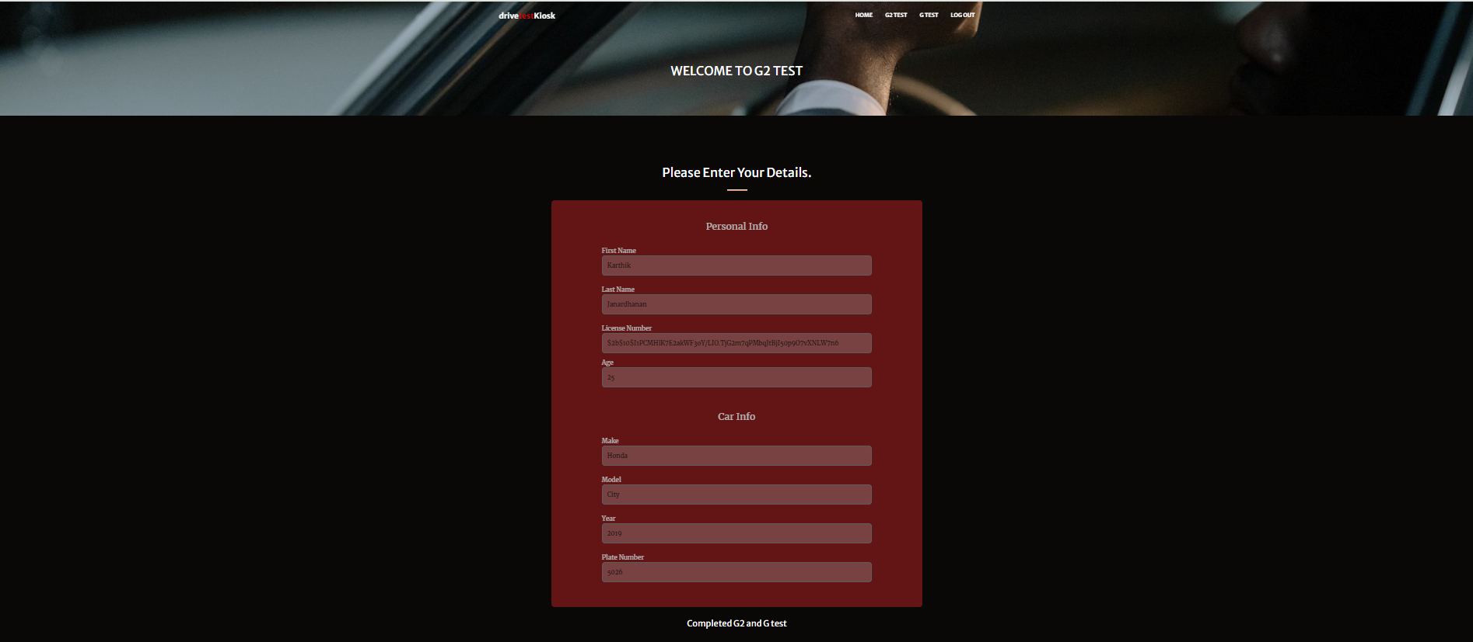
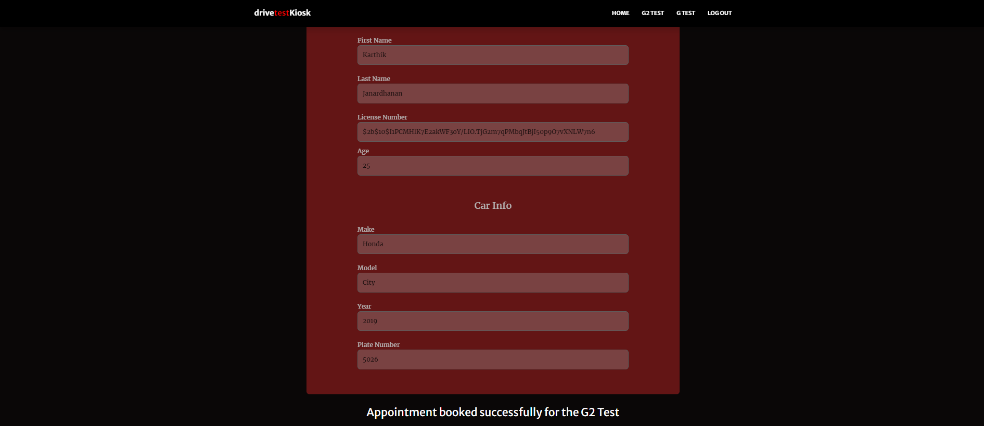
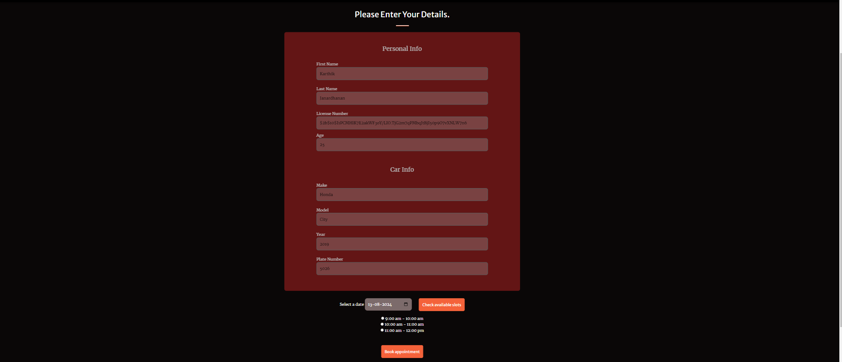
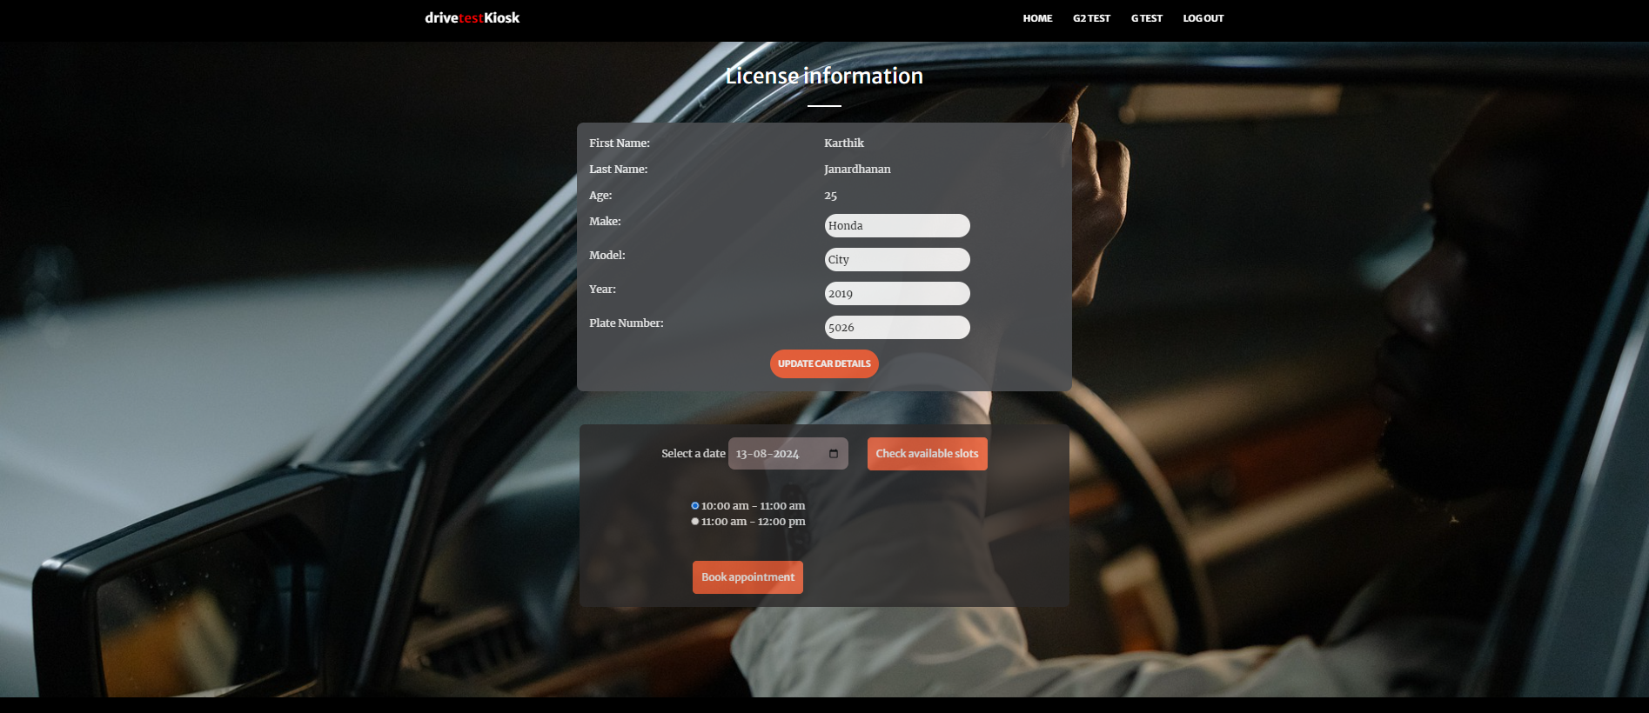
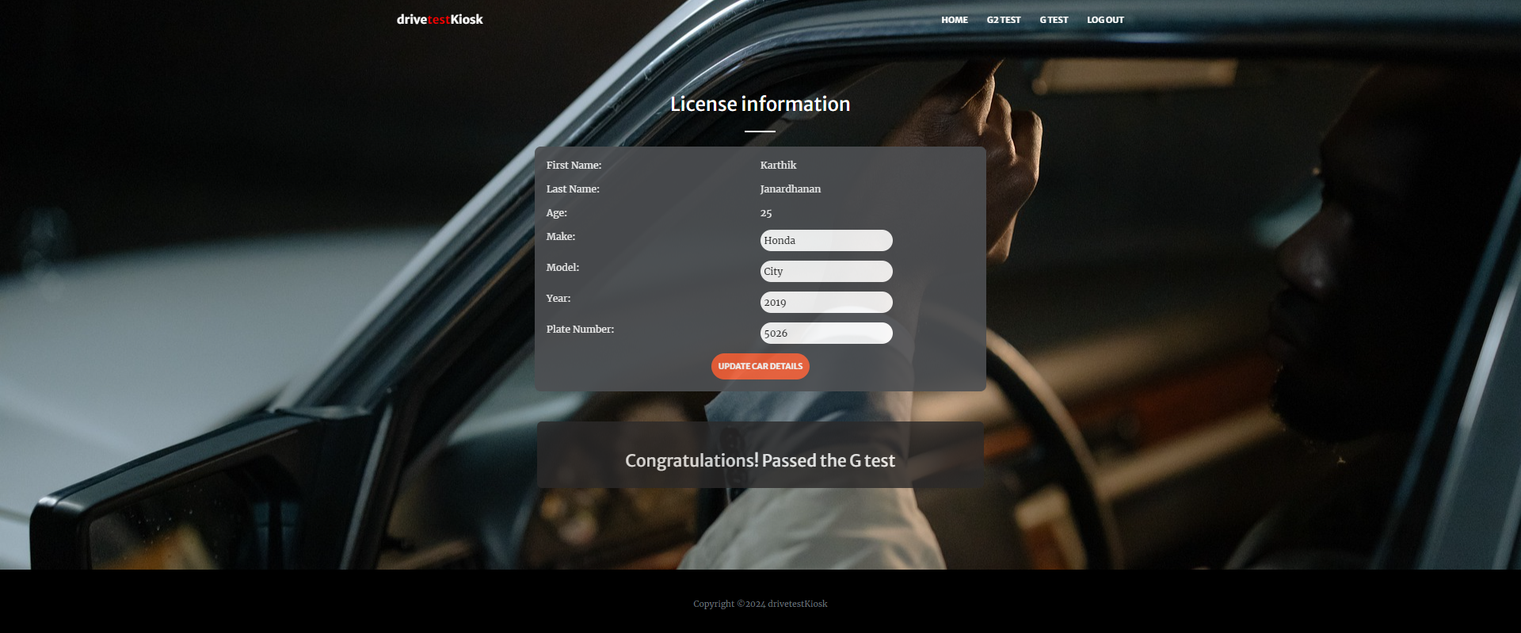
Driver Life Cycle

Slide 21
CONTRIBUTIONS
Alfredo Uriarte – Functionality In G2 Test And Admin Part
Susmi Rani – Functionality In Examiner And G Test
Asif Mujeeb – Design And UI Development
Karthik Janardhanan - Design And Testing Flow

